Slide 1

Movie Recommender For Twitter Users
PRESENTED BY OVERFITTERS
Aayush Agrawal
William Eerdmans
Wendy Lu
Wenrui Liu

Slide 2

Want to test our system?
A volunteer in this classroom has provided 6 movie ratings, and our recommender system will generate 10 movies for him

Slide 3



Our goal is to provide personalized trailer tweets to users
Homepage Takeover
First View
OR
Entertaining

Slide 4



Recommender Systems help to improve users’ experience and marketing efficiency
Over 47,000 unique Twitter users
Additional Movie Features:
Genre
Year
Awards (1/0)
Run time
Language
Plot
26,534 unique movies from IMDb
Over 554,992 ratings
Each user rates 12 movies on average
Each movie gets 21 ratings on average

Slide 5
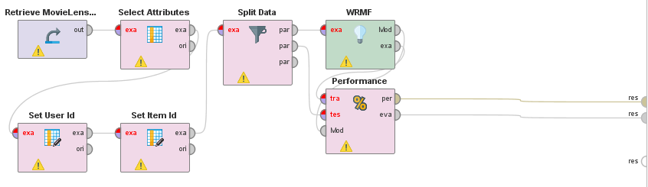
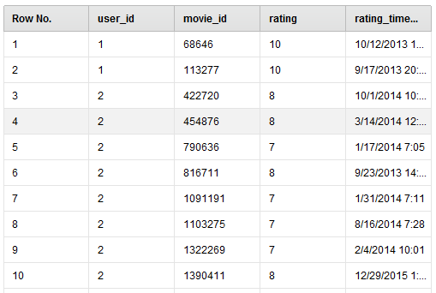
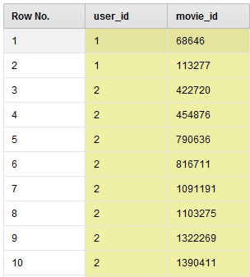
RapidMiner generated a quick model prototype, Python on the other hand not as much
import pandas as pd
import codecs
from math import sqrt
ratings = pd.read_csv('ratings.csv',usecols = [0,1,2])
def to_dict (frame):
d = {}
for row in frame.values:
user = row[0]
movie = row[1]
rating = row[2]
if user not in d:
d[user] = {}
d[user][movie]=rating
else:
d[user][movie]=rating
return d
temp = to_dict(ratings)
def pearson(rating1, rating2):
sum_xy = 0
sum_x = 0
sum_y = 0
sum_x2 = 0
sum_y2 = 0
n = 0
for key in rating1:
if key in rating2:
n += 1
x = rating1[key]
y = rating2[key]
sum_xy += x * y
sum_x += x
sum_y += y
sum_x2 += pow(x, 2)
sum_y2 += pow(y, 2)
if n == 0:
return 0
# now compute denominator
denominator = sqrt(sum_x2 - pow(sum_x, 2) / n) * sqrt(sum_y2 - pow(sum_y, 2) / n)
if denominator == 0:
return 0
else:
return (sum_xy - (sum_x * sum_y) / n) / denominator
def computeNearestNeighbor(u, ratings):
"""creates a sorted list of users based on their distance to username"""
distances = []
for user in ratings:
if user != u:
distance = pearson(ratings[user], ratings[u])
if distance <> 0:
distances.append((distance, user))
# sort based on distance -- closest first
distances.sort()
return distances
def recommend(u, ratings):
"""Give list of recommendations"""
# first find nearest neighbor
distances = computeNearestNeighbor(u, ratings)
if not distances:
return
else:
nearest = distances[0][1]
recommendations = []
# now find movies neighbor rated that user didn't
neighborRatings = ratings[nearest]
userRatings = ratings[u]
for movie in neighborRatings:
if not movie in userRatings:
recommendations.append((movie, neighborRatings[movie]))
# using the fn sorted for variety - sort is more efficient
# reurn top 5 movie recommendations
return sorted(recommendations, key=lambda movieTuple: movieTuple[1], reverse = True)[:5]

Slide 6

Adding movie features in GraphLab for more sophisticated model
A product of turi.com which allows scalable machine learning applications
Graphlab has a variety of recommender system
Used factorized machine (generalized version of matrix factorization and combined SVD)
FM can create latent features and use additional attributes of movies:
Genre, Year, Awards, and Run time

Slide 7
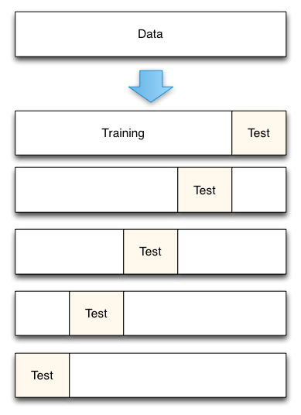
Using RMSE as a main evaluation measurement
5-fold Cross Validation
RMSE
Other evaluations to consider?
+/- 1.6498 off from true ratings on a 10-score scale
Coverage
Serendipity
Utility
Robustness
 | User | Movie | Rating
Ture | 2333 | Interstellar (2014) | 10
Pred. | 2333 | Interstellar (2014) | 9.2

Slide 8
Optimize model performance using different features
1
FM with only Rating Database
RMSE: 1.6944
II
FM with Rating Database + Movie Genre
RMSE: 1.8224
III
FM with Rating Database + Movie OMDB RMSE: 1.6567
FM with Rating Database
+ Genre
+ Movie OMDB
RMSE :1.6498

Slide 9
Using RMSE as a main evaluation measurement
5-fold Cross Validation
RMSE
Other evaluations to consider?
+/- 1.6498 off from true ratings on a 10-score scale
Coverage
Serendipity
Utility
Robustness
 | User | Movie | Rating
Ture | 2333 | Interstellar (2014) | 10
Pred. | 2333 | Interstellar (2014) | 9.2

Slide 10

RapidMiner enables quick deployment without coding
Up and running within minutes
No prerequisite for any programming language knowledge
Ideal for proof of concept and demonstration purpose

Slide 11







GraphLab enables a scalable solution for real-time predictions
Train
Historical Data
Recommend
Evaluation
Model
Live Data
Notes:
Parameters and configurations of Cloudera Hadoop cluster. We can change the environment to an EC2 cluster by simply changing the environment to ec2-prod

Slide 12

Recommend movie trailers via promoted Tweets

Slide 13

Thank You
Here is Panos’ top 10 movie recommending

